Slide 1

2024 →2025
VCE Health and Human Development
Transition
Units 1&2

Slide 2


What will I study in this subject?
Unit 1: Understanding health and wellbeing
This unit delves into health and wellbeing as a concept and explores varied and evolving perspectives and definitions, including those of youth and Aboriginal and Torres Strait Islander Peoples. Students investigate the World Health Organization (WHO) prerequisites for health as well as factors that influence health attitudes, beliefs and practices. Students explore the indicators used to measure and evaluate health status and they build their health literacy by interpreting and using data in a research investigation into one youth health focus area. Finally, they spend time exploring food and nutrition as foundations for good health.

Slide 3



What will I study in this subject?
Unit 2: Managing health and development
This unit explores the human lifespan, including transitions from youth into adulthood. There is a focus on aspects of healthy and respectful relationships and considerations in becoming a parent, including the impact parents have on the optimal development of children. Students also investigate the health system in Australia, including Medicare and the PBS, from the perspective of youth and their rights and responsibilities. They inquire into factors affecting youth’s access to health services and information. Students also research the range of health services in their communities and suggest ways of improving the health literacy and health outcomes of youth.

Slide 4

How will I be assessed?
Unit 1 Assessment | Marks allocated | Percent contribution to Unit 1
Outcome 1 SAC | 30 | 30%
Outcome 2 SAC | 30 | 30%
Outcome 3 SAC | 40 | 40%
Unit 2 Assessment | Marks allocated | Percent contribution to Unit 2
Outcome 1 SAC | 30 | 30%
Outcome 2 SAC | 30 | 30%
Unit 1/2 Exam | 100 | 40%

Slide 5


Achieving success in vce hhd
How do I ensure I achieve an 'S' for this subject?
You must achieve an 'S' in each of the outcomes to pass this subject. In order to do this, you need to ensure the following:
- You complete all Assessments/SACs.
- You maintain high levels of class attendance.
- You complete set coursework such as assigned textbook questions and homework.
What is our holiday homework?
Over the holidays you must complete the following:
- All sections of the Transition Booklet.
- The assigned Textbook Questions.
- Notes on the first key knowledge point - 1.1.1.

Slide 6
Transition timeline
Unit, Area of Study and Outcome | Week | Key knowledge | Key Skills | Coursework and Assessment tasks
Unit 1 - Understanding health and wellbeing Area of Study 1 - Concepts of health Outcome 1 | 1 | Various definitions of health and wellbeing: physical, social, emotional, mental and spiritual dimensions | Describe and analyse various perspectives, definitions and interpretations of health and wellbeing Explain different dimensions of health and wellbeing | Holiday homework: Complete Transition Booklet and Textbook Chapter Questions

Slide 7

Area of study 1 OUtcome
On completion of this unit, the student should be able to explain multiple dimensions of health and wellbeing, explain indicators used to measure health status and analyse sociocultural factors that contribute to variations in the health status of youth.

Slide 8

Key knowledge and skills – 1.1.1
Key knowledge point
Various definitions of health and wellbeing: physical, social, emotional, mental and spiritual dimensions
Key skills
Describe and analyse various perspectives, definitions and interpretations of health and wellbeing
Explain different dimensions of health and wellbeing

Slide 9
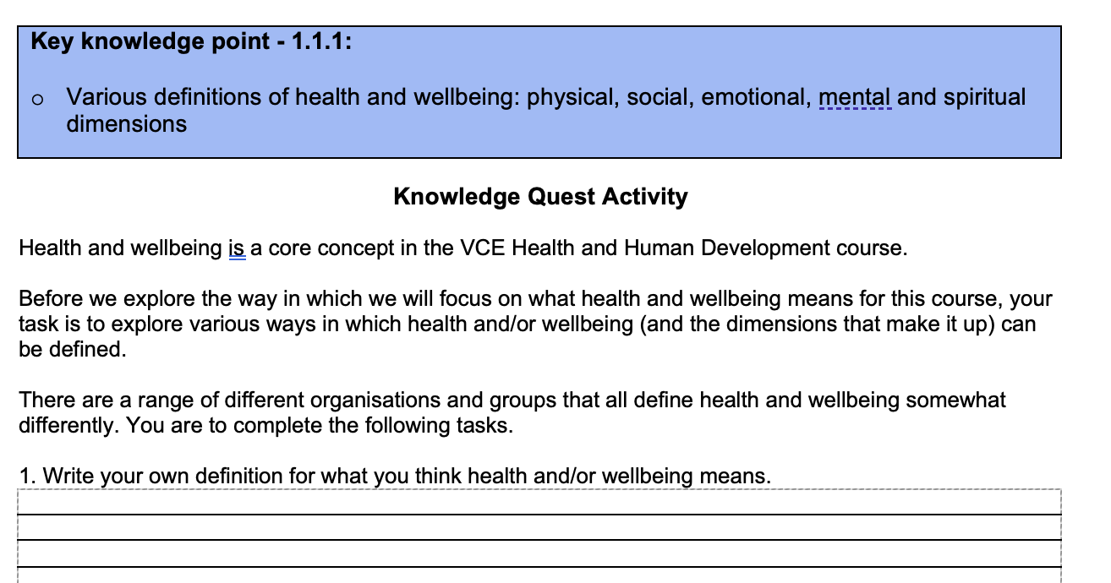
Complete the knowledge quest activity in your booklet
Before we dive into the course content, explore what health and wellbeing and the various dimensions of health mean by completing the Knowledge Quest Activity.

Slide 10
What is health and wellbeing?
Health
Wellbeing
Health and wellbeing
There is not one universally accepted definition for health and wellbeing, and over time there has been much debate about the meaning of this concept.
In modern times, health and wellbeing is often considered and referred to as one concept, however each term can be considered separately:
Health can be considered a person’s physical, social, emotional, mental and spiritual dimensions.
Wellbeing can be considered an equilibrium in which the individual feels happy, healthy, capable and engaged.
For the purpose of this subject, we will consider health and wellbeing as a single concept, as wellbeing is an implicit element of health.
We will use this description: Health and wellbeing relates to a person’s physical, social, emotional, mental and spiritual existence, and is characterised by an equilibrium in which the individual feels happy, healthy, capable and engaged.

Slide 11


Various definitions of health and wellbeing
One of the most commonly referenced definitions of health comes from the World Health Organization who stated in 1946 that health is ‘a state of complete physical, mental and social wellbeing and not merely the absence of disease or infirmity’.
The key skill for this part of the course is to ‘describe and analyse various perspectives, definitions and interpretations of health and wellbeing’. When looking at the 1946 WHO definition it useful to consider the following:
  It only includes three dimensions, not the five that were mentioned on the previous slide
  It refers to ‘a state of complete…’ indicating that the highest levels of each dimension needs to be obtained to achieve health. This is a very high bar to set for most people.
In 1986 the WHO provided more detail regarding the concept of health and added that ‘Health is, therefore, seen as a resource for everyday life, not the objective of living. Health is a positive concept emphasizing social and personal resources, as well as physical capacities’. This therefore made health more achievable for the average person and included a greater focus on an individual’s own resources and situation when determining the achievement of health, it moved away from requiring ‘complete physical, mental and social wellbeing’ to achieve health.

Slide 12


Various definitions of health and wellbeing
As mentioned on the previous slide, you may be asked to describe and analyse various perspectives, definitions and interpretations of health and wellbeing. Consider this description from the Australian Institute of Health and Welfare:
Health is a state of wellbeing. It reflects the complex interactions of a person’s genetics, lifestyle and environment. Generally, a person’s health depends on two things: determinants (factors that influence health) and interventions (actions taken to improve health, and the resources required for these interventions). Source: https://www.aihw.gov.au/getmedia/e546e087-d50d-42da-a53d-35e528643d97/aihw-aus-221-chapter-1-1.pdf.aspx
Take a moment to consider what some of the strengths and limitations of this description of health are.

Slide 13
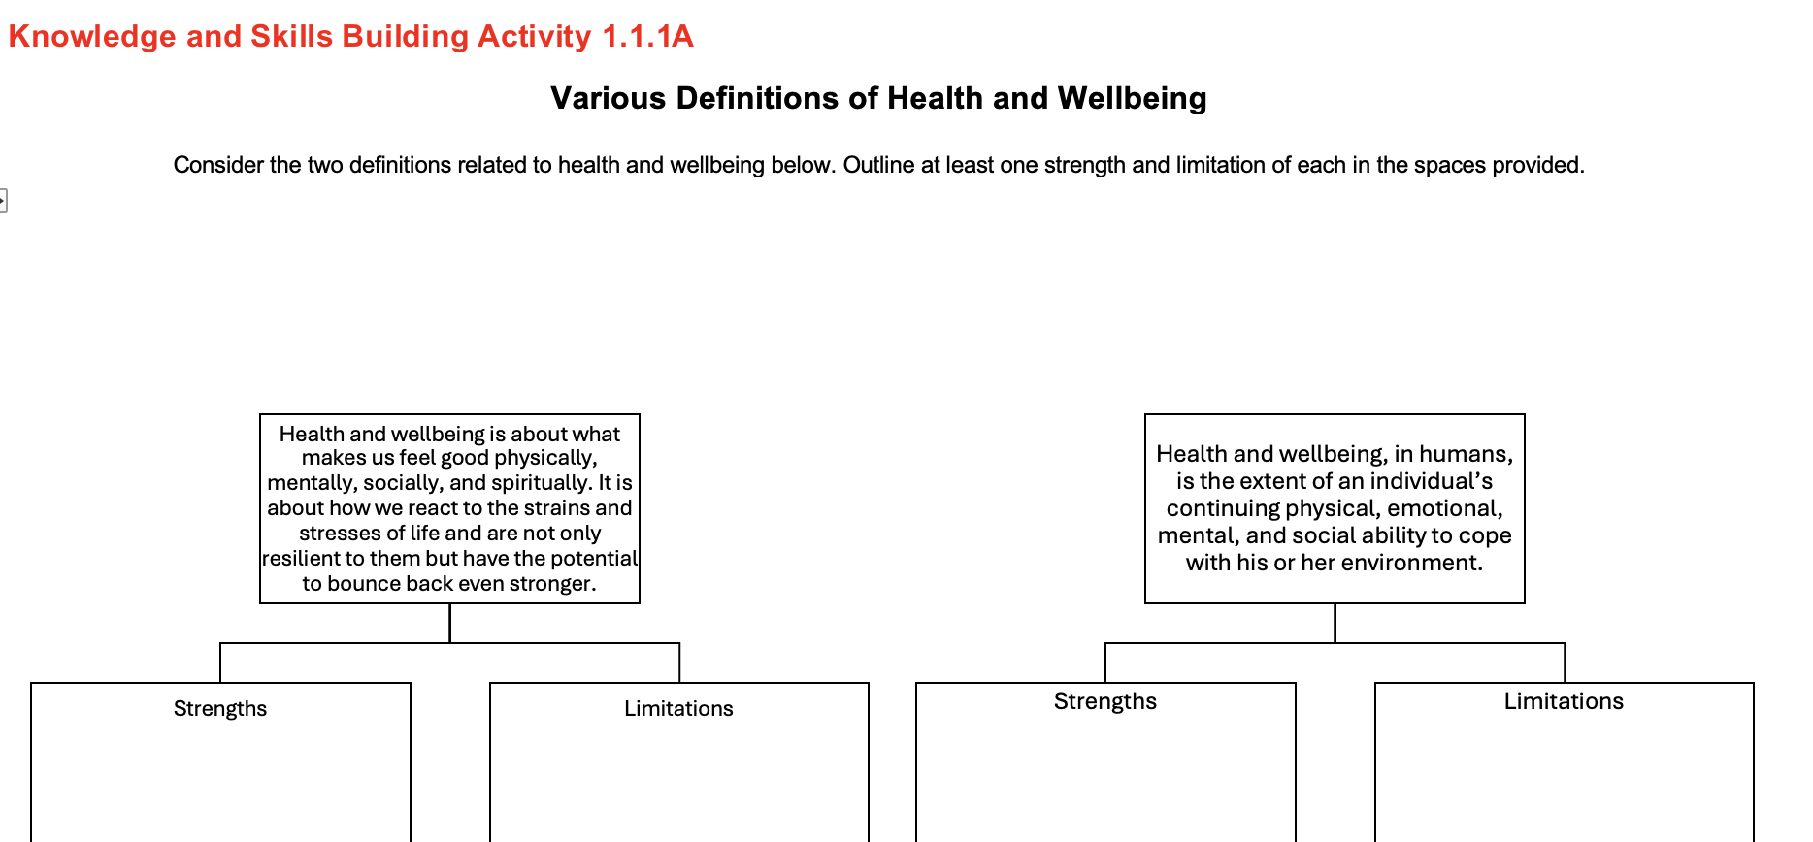
Complete the Knowledge and skills building activity 1.1.1a in your booklet

Slide 14
What are the dimensions of health and wellbeing?
Dimensions of health and wellbeing
Physical
Social
Mental
Emotional
Spiritual
The concept of health and wellbeing has evolved over time, in the past, there was a greater focus on just the physical aspect of health and wellbeing, but as society has evolved, we have come to understand that all of the various dimensions of health and wellbeing are important and play a role in maintaining high levels of overall health and wellbeing. The five dimensions we now consider to make up health and wellbeing are:
Physical
Mental
Social
Emotional
Spiritual
It is important to acknowledge that these five dimensions of health a​re not isolated but are interrelated and influence each other.
Physical MESS is a useful mnemonic to remember the five dimensions of health and wellbeing, where each letter in MESS is the first letter of a different dimension.

Slide 15

What is physical health and wellbeing?
Description: Physical health and wellbeing relates to the functioning of the body and its systems and it includes the physical capacity to perform daily activities or tasks.
Physical health and wellbeing is supported by factors such as regular physical activity, consuming a balanced diet, having appropriate rest/sleep, maintaining an ideal body weight, and the absence of illness, disease or injury.
On the next slide, the examples of the physical dimension of health and wellbeing demonstrate characteristics or ‘key phrases’ that you include in your answers when making links to physical health and wellbeing.

Slide 16
What are examples of the physical dimension of health and wellbeing?
Physical health and wellbeing
Function of the immune system
Energy levels
Body weight
Ability to complete daily physical tasks
Levels of fitness
Levels of disease and illness
Functioning of the body and systems

Slide 17
What are examples of the physical dimension of health and wellbeing?
In the table below we will explore in more detail some of the examples of the physical dimension of health and wellbeing so that you can confidently link to these when using them in an example.
 | Function of the immune system | Energy levels | Levels of disease and illness | Ability to complete daily tasks
How does this example relate to the physical dimension of health and wellbeing? | Our bodies immune system helps us to fight off bacteria and viruses that can cause disease, as well as playing a role in stopping a range of other diseases from developing. A well-functioning immune system can be a protective factor from disease. | The food and beverages that we consume, as well as the activities we participate in, can influence our energy levels. Having adequate energy allows us to engage in activities that can promote our physical health and wellbeing such as sports and leisure activities. | When people experience disease and illness their body is not functioning optimally. This can contribute to pain and discomfort, as well as a reduced ability to participate in other health promoting activities such as exercise. | Daily tasks can include things like housework, running errands and cooking a meal. The ability to complete such tasks indicates our body is in working order and that we are able to carry on with our day to day lives.

Slide 18

Linking to physical health and wellbeing
When referring to this dimension, it is useful to think about how to use examples of physical health and wellbeing in an answer, as this demonstrates that you are making a clear link to the dimension.
For this and the other four dimensions, we will consider how attending school and participating in the workforce can promote each.
Attending school: At school students are likely to participate in physical education classes where they have the opportunity to be active and improve their fitness levels.
Participating in the workforce: people’s employers may offer free annual health check-ups or the opportunity to be vaccinated for free from common conditions such as the flu. This can help to detect and prevent health conditions, therefore helping to reduce levels of disease and illness.

Slide 19
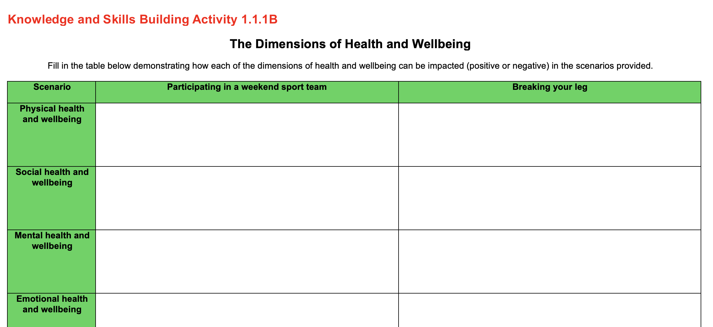
Complete the Knowledge and skills building activity 1.1.1B in your booklet
Complete the first row of the table in your booklet regarding how the physical dimension of health and wellbeing can be impacted in the scenarios provided.

Slide 20

What is social health and wellbeing?
Description: Social health and wellbeing relates to the ability to form meaningful and satisfying relationships with others and the ability to manage or adapt appropriately to different social situations.
Social health and wellbeing also includes the level of support provided by family and within a community to ensure that every person has equal opportunity to function as a contributing member of the society.
Social health and wellbeing is supported by strong communication skills, empathy for others and a sense of personal accountability.
On the next slide, the examples of the social dimension of health and wellbeing demonstrate characteristics or ‘key phrases’ that you include in your answers when making links to social health and wellbeing.

Slide 21
What are examples of the social dimension of health and wellbeing?
Social health and wellbeing
Network of family and friends
Ability to clearly communicate with others
Ability to manage or adapt to different social settings
Ability to develop and maintain relationships with others
Contributions to social groups and the community

Slide 22
What are examples of the social dimension of health and wellbeing?
In the table below we will explore in more detail some of the examples of the social dimension of health and wellbeing so that you can confidently link to these when using them in an example.
 | Network of family and friend | Ability to clearly communicate with others | Ability to develop and maintain relationships | Contributions to social groups and the community
How does this example relate to the social dimension of health and wellbeing? | The family and friends of an individual are often the most formative people in one’s life. These are the individuals we generally speak to most often and have many of our closest and most loving relationships with. Therefore, this network heavily impacts the development of our communication skills and ability to develop and maintain relationships with others. | Being able to express our ideas and tell someone what we are thinking and feeling is important to developing and maintaining relationships. Effective communication can also help us to contribute to society through employment and social participation. | There is a wide range of types of relationships, whether they be family, professional or intimate. Our ability to move between and maintain various relationships helps to sustain us and bring fulfillment to different aspects of our life and gives us the opportunity to communicate and express ourselves in different ways. | Social groups may include parent groups or sport teams. By participating in such groups we can interact with a wide range of people and learn to communicate in varied and complex ways. These groups can lead to us making and sustaining new friendships and relationships.

Slide 23

Linking to social health and wellbeing
When referring to this dimension, it is useful to think about how to use examples of social health and wellbeing in an answer, as this demonstrates that you are making a clear link to the dimension.
As with the previous dimension, we will consider how attending school and participating in the workforce can promote this dimension.
Attending school: young people have the opportunity to spend time with their friends during the day, allowing them to build and maintain satisfying and meaningful relationships.
Participating in the workforce: as part of being employed, skills such as verbal and non-verbal communication are likely to be developed, improving the ability to communicate effectively.

Slide 24
Complete the Knowledge and skills building activity 1.1.1B in your booklet
Complete the second row of the table in your booklet regarding how the social dimension of health and wellbeing can be impacted in the scenarios provided.

Slide 25

What is mental health and wellbeing?
Description: Mental health is the current state of wellbeing relating to the mind or brain and it relates to the ability to think and process information. A mentally healthy brain enables an individual to positively form opinions, make decisions and use logic.
Mental health is about the wellness of the mind rather than illness. Mental health is associated with low levels of stress and anxiety, positive self-esteem, as well as a sense of confidence and optimism.
On the next slide, the examples of the mental dimension of health and wellbeing demonstrate characteristics or ‘key phrases’ that you include in your answers when making links to mental health and wellbeing.

Slide 26
What are examples of the mental dimension of health and wellbeing?
Mental health and wellbeing
Level of confidence in yourself and your abilities
Ability to reason and form opinions and make decisions
Level of optimism and positive thought patterns
Level of anxiety and stress
Ability to think logically and problem solve
Level of self-esteem

Slide 27
What are examples of the mental dimension of health and wellbeing?
In the table below we will explore in more detail some of the examples of the mental dimension of health and wellbeing so that you can confidently link to these when using them in an example.
 | Level of anxiety and stress | Ability to think logically and problem solve | Level of self-esteem | Ability to reason and form opinions and make decisions
How does this example relate to the mental dimension of health and wellbeing? | Low levels of stress and anxiety can help us to think clearly and make rational decision. With less worry, we can sleep and rest better, and this helps to keep our minds functioning clearly so that we can problem solve and reason. | When we are able to solve problems and think clearly, we are less likely to be stressed and are better able to manage the challenges that we encounter each day. This also helps us to engage in education or complete our job, which can then lead to outcomes such as earning an income, consequently reducing financial stress. | Self-esteem relates to our opinion of ourselves. A higher self-esteem increases the likelihood we will participate in challenging activities, as we are more likely to think we can be successful. This can then improve the skills we have to complete such tasks and increase our confidence. | Being able to consider information and make reasoned decision indicates that we are able to think and that our brain in functioning well. This can also improve our ability to engage in education and work, which can lead to the development of new skills and increase our self-esteem and confidence.

Slide 28

Linking to mental health and wellbeing
When referring to this dimension, it is useful to think about how to use examples of mental health and wellbeing in an answer, as this demonstrates that you are making a clear link to the dimension.
As with the previous dimensions, we will consider how attending school and participating in the workforce can promote this dimension.
Attending school: students are likely to learn strategies to manage stress and anxiety, such as exercise and mindfulness, helping to manage their mental health and wellbeing.
Participating in the workforce: people may learn problem solving and reasoning skills as part of their job, improving their ability to make logical decisions.

Slide 29
Complete the Knowledge and skills building activity 1.1.1B in your booklet
Complete the third row of the table in your booklet regarding how the mental dimension of health and wellbeing can be impacted in the scenarios provided.

Slide 30

What is emotional health and wellbeing?
Description: Emotional health relates to the ability to express feelings in a positive way. Emotional health is about the positive management and expression of emotional actions and reactions, as well as the ability to display resilience.
Emotional health is the degree to which you feel emotionally secure and relaxed in everyday life.
On the next slide, the examples of the emotional dimension of health and wellbeing demonstrate characteristics or ‘key phrases’ that you include in your answers when making links to emotional health and wellbeing.

Slide 31
What are examples of the emotional dimension of health and wellbeing?
Emotional health and wellbeing
Ability to display resilience
Ability to recognise and understand a wide range of emotions in others
Ability to respond to and manage your own emotions appropriately
Ability to experience appropriate emotions in a range of different scenarios

Slide 32
What are examples of the emotional dimension of health and wellbeing?
In the table below we will explore in more detail some of the examples of the emotional dimension of health and wellbeing so that you can confidently link to these when using them in an example.
 | Ability to display resilience | Ability to recognise and understand a wide range of emotions in others | Ability to respond to and manage your own emotions appropriately | Ability to experience appropriate emotions in a range of different scenarios
How does this example relate to the emotional dimension of health and wellbeing? | Resilience is the ability to bounce back from and overcome challenges. The ability to display this indicates that we can manage challenging situations, including the range of feelings and emotions they may evoke, and successfully navigate them. | Being able to recognise emotions in others can help us to respond appropriately to how people are feeling. This may help to strengthen our connections with those that we are close to, and when reciprocated, provides us with the opportunity to express our emotions and receive appropriate support. | We all experience a wide range of emotions such as joy, sadness, anger and frustration. Being able to understand and manage such emotions prevents us from acting in ways that can be damaging to ourselves and others. | The emotions we experience at a birthday party are likely to be very different to those we might experience at a funeral. Depending on the setting, we typically experience and display a number of different emotions appropriate to the setting.

Slide 33

Linking to emotional health and wellbeing
When referring to this dimension, it is useful to think about how to use examples of emotional health and wellbeing in an answer, as this demonstrates that you are making a clear link to the dimension.
As with the previous dimensions, we will consider how attending school and participating in the workforce can promote this dimension.
Attending school: students may be taught how to respond and manage a range of emotions in challenging situations, such as anger and frustration.
Participating in the workforce: people are likely to face challenges in the workplace, and learning how to overcome these with colleagues helps to build resilience.

Slide 34
Complete the Knowledge and skills building activity 1.1.1B in your booklet
Complete the fourth row of the table in your booklet regarding how the emotional dimension of health and wellbeing can be impacted in the scenarios provided.

Slide 35

What is spiritual health and wellbeing?
Description: Spiritual health is not material in nature, but relates to ideas, beliefs, values and ethics that arise in the minds and conscience of human beings. Spiritual health includes the concepts of hope, peace, a guiding sense of meaning or value, and reflection on your place in the world.
Spiritual health can be highly individualised, for example, for some spiritual health may relate to organised religion, a higher power and prayer, whilst for others it can relate to morals, values, a sense of purpose in life, connection and/or belonging.
In the next slide, the examples of the spiritual dimension of health and wellbeing demonstrate characteristics or ‘key phrases’ that you include in your answers when making links to spiritual health and wellbeing.

Slide 36
What are examples of the spiritual dimension of health and wellbeing?
Spiritual health and wellbeing
Level of meaning and purpose in life
Ability to live by a set of values and beliefs
Level of hope for a positive future
Level of belonging and connection to something greater than yourself
Ability to be at peace and reflect on your place within the world

Slide 37
What are examples of the spiritual dimension of health and wellbeing?
In the table below we will explore in more detail some of the examples of the spiritual dimension of health and wellbeing so that you can confidently link to these when using them in an example.
 | Level of meaning and purpose in life | Ability to live by a set of values and beliefs | Ability to be at peace and reflect on your place within the world | Level of hope for a positive future
How does this example relate to the spiritual dimension of health and wellbeing? | There are many ways that people can derive purpose and meaning in their life. This may come from their job, or another activity such as volunteer work or taking care of an unwell family member. Some people also find meaning in serving others or a higher power, such as a religious god. | Our values and beliefs may be developed as a result of our upbringing, the people we associate with or a group we belong to. These values and beliefs can influence how we live our lives and provide direction for us particularly during challenging times. | To be able to feel an inner calm and realise your position in the scheme of the world can help to put everyday challenges into perspective. Some people find peace by going for a walk in nature while others may participate in regular meditation or mindfulness activities. | The ability to look ahead and imagine that things will be positive can often help people to endure challenging times. This can often be accompanied by regular meditation or prayer which some people find comforting when facing challenges and hoping for a positive future.

Slide 38

Linking to spiritual health and wellbeing
When referring to this dimension, it is useful to think about how to use examples of spiritual health and wellbeing in an answer, as this demonstrates that you are making a clear link to the dimension.
As with the previous dimensions, we will consider how attending school and participating in the workforce can promote this dimension.
Attending school: at school students may learn about caring for others, and then develop values and beliefs which help to provide a guiding sense of meaning in their life.
Participating in the workforce: employment may provide people with a sense of purpose in their life as they work towards goals, and it may provide them with a sense of connection to something that is bigger than just themselves.

Slide 39
Complete the Knowledge and skills building activity 1.1.1B in your booklet
Complete the fifth row of the table in your booklet regarding how the spiritual dimension of health and wellbeing can be impacted in the scenarios provided.

Slide 40

Assessment tips
If a question asks about ‘health and wellbeing’, you should be referring to one or more dimensions of health and wellbeing in your answer.
You should use the style of question and the number of marks allocated to help guide the level of depth you provide in your answers.
From the Study Design: ‘For the purposes of this study, the term ‘health’ is a broad, overarching term that includes the concepts of health and wellbeing, health status and associated health outcomes.’ Therefore, if a question asks how something may influence or promote health or health outcomes, you should be referring to one or more dimensions of health and wellbeing or health status indicators (covered later in the course) in your answer.
Remember, you should always write a term such as health and wellbeing out in full before abbreviating this to something such as ‘H&W’. Only abbreviations found in the Study Design are not required to be written out in full before being used as an abbreviation.

Slide 41

Key skills and common questions
The key skills for this section of the course are:
Describe and analyse various perspectives, definitions and interpretations of health and wellbeing
Explain different dimensions of health and wellbeing
Therefore, common questions may include:
- Examples of different perspectives, definitions and interpretations of health and wellbeing which you are asked to analyse and provide examples of strengths and/or limitations of these.
- A case study/scenario where you are asked to explain how the dimensions of wellbeing are reflected or linked to information in the scenario.
- Describing and providing examples of the different dimensions of health and wellbeing.

Slide 42

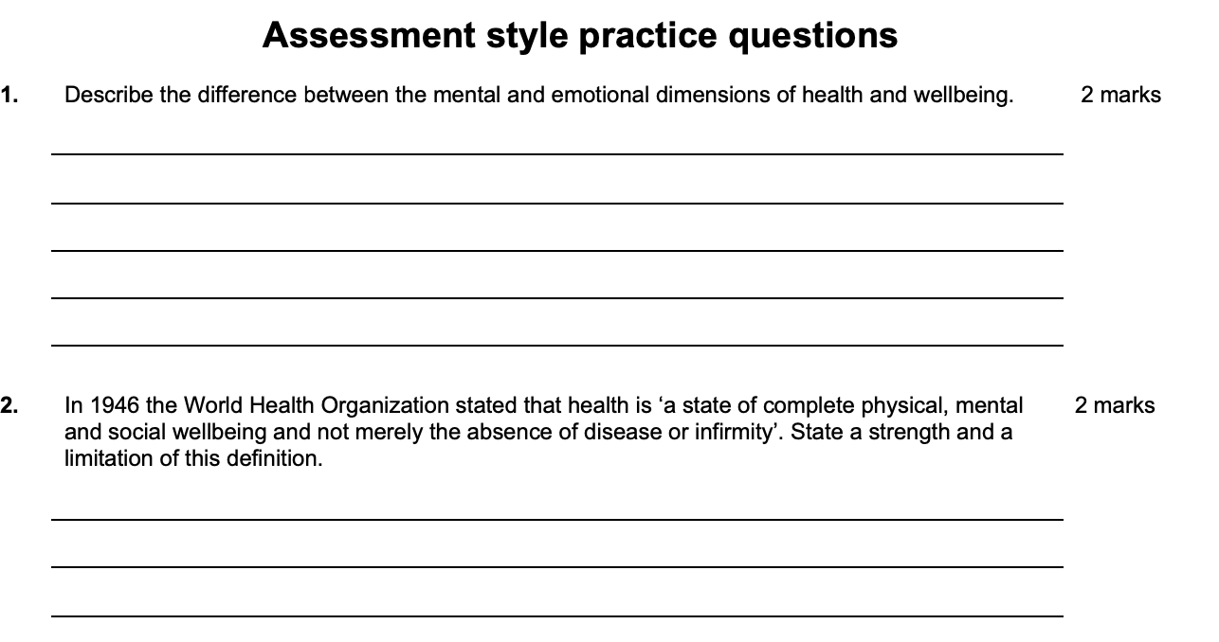
Complete the assessment style practice questions in your booklet
Complete the Assessment style practice questions in your booklet.

Slide 43
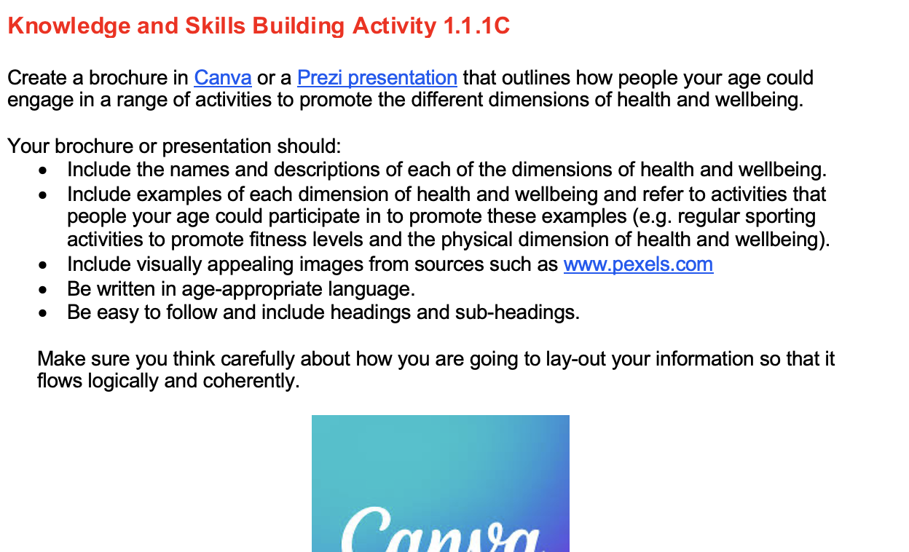
Complete the Knowledge and skills building activity 1.1.1c in your booklet

