Slide 1
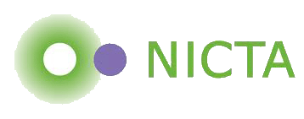


Historically Interesting Voting Rules:
Electing the Doge
Toby Walsh
Lirong Xia
Auckland, Feb 20th 2012

Slide 2
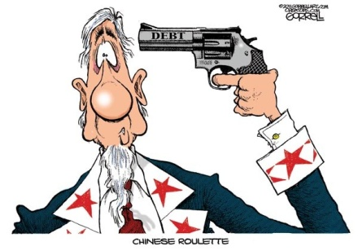
Executive summary
We study the impact of a randomized pre-round to eliminate some voters

Slide 3
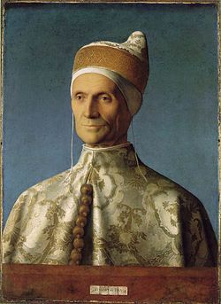
Electing the Doge
Leonardo Loredan,
Doge 1501-1521

Slide 4
Electing the Doge
Leonardo Loredan,
Doge 1501-1521
Art history aside: One of the 1st portraits of a mortal that is not in profile

Slide 5
Electing the Doge
Similar voting rules used in many other Italian cities

Slide 6
Electing the Doge
One of the longest running electoral systems
  Used between 1268 and 1797
One of the most complex electoral systems
  10 rounds of voting!

Slide 7
Electing the Doge
“The main idea . . . seems to have been to introduce a system of election so complicated that all possibility of corruption should be eliminated” [Wolfson 1899]

Slide 8
Electing the Doge
“actions which do not increase security, but which are designed to make the public think that the organization carrying out the actions is taking security seriously…. offers some resistance to corruption of voters” [Mowbray&Gollmann 07]

Slide 9





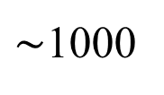





Electing the Doge
$∼$1000
lottery
$$30$$
Round 1:
Round 2:
Round 3:
Round 10:
$$30$$
lottery
$$9$$
Approval like voting
$$9$$
$$40$$
…
$$41$$
Plurality
The winner must receive >24 votes

Slide 10
Electing the Doge
1000 (male and 30 years and older) members of the Maggior Consiglio
Reduce by lot to 30 then 9, then elect 40
Reduce by lot to 12, then elect 25
Reduce by lot to 9, then elect 45
Reduce by lot to 11, then elect 41
These 41 elect Doge

Slide 11
Electing the Doge
This still only a simplified description
  Only one person from each family allowed to be selected in each lottery
  None of the electoral colleges of size 9, 11 or 12 were allowed to be members of final 41
  Enlarging electoral college used an “approval” like rule, each voter nominates a candidate, they need to receive a threshold of approvals
  …

Slide 12
Electing the Doge
Two interesting features
  Lottery to eliminate some voters
  Voters vote not on the Doge but on themselves and who goes through to next round

Slide 13
Electing the Doge
Two interesting features
  Lottery to eliminate some voters (THIS TALK)
  Voters vote not on the Doge but on themselves and who goes through to next round (FUTURE WORK)

Slide 14
Lot based voting
LotThenX
  Run a lottery to pick a subset of k voters
  Then run voting rule X
  Doge election used several rounds of LotThenApproval

Slide 15
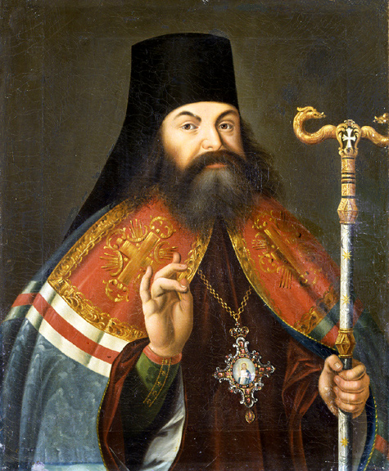
Lot based voting
Many other Italian cities
Election of Archbishop of Novgorod
  One of oldest offices in Russian Orthodox Church

Slide 16
Lot based voting
Many other Italian cities
Election of Archbishop of Novgorod
  One of oldest offices in Russian Orthodox Church
City-state of Athens

Slide 17


Lot based voting
In use today
Election of the Chair of the Internet Engineering Task Force
  Standards committee for TCP/IP and other internet protocols
  Random subset of 10 of the 100+ electorate chose the chair
Russ Housley

Slide 18
Lot based voting
Lottery used to select Citizen’s Assembly that voted on electoral reform in BC (2004)
  For the curious, they decided on STV

Slide 19
Lot based voting
Lottery used to select Citizen’s Assembly that voted on electoral reform in BC (2004)
  For the curious, they decided on STV
Lottery used to select Citizen’s Assembly that voted on electoral reform in ON (2006)
  For the curious, proportional system they recommended rejected by voters of ON

Slide 20
Lot based voting
Spanish savings banks
  To elect committee that represents account holders
Proposed to reform the British House of Lords, and US House of Representatives

Slide 21
Why use lotteries?
Arguments for:
  Representative
  Egalitarian
  Less corruptible
  Power to ordinary people
  No voter fatigue
  No political parties
  ..

Slide 22
Why use lotteries?
Arguments for:
  Representative
  Egalitarian
  Less corruptible
  Power to ordinary people
  No voter fatigue
  No political parties
  ..
Arguments against:
  Can select unqualified people
  Can select people holding minority views
  Accountability
  Verification of randomness
  …

Slide 23
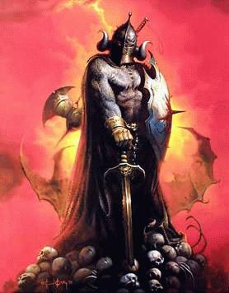
This Talk
Does using a lottery provide some shield against manipulation?
  If it makes it (computationally) hard to predict who wins, perhaps we’ll have no alternative but to vote truthfully

Slide 24
Previous work
LotThenX is a randomized voting rule
  [Gibbard 77] proved that with 3+ candidates, a randomized voting rule that satisifes Pareto optimality is a random dictatorship
  LotThenX if k=1

Slide 25
Previous work
LotThenX is a randomized voting rule
  [Gibbard 77] proved that with 3+ candidates, a randomized voting rule that satisifes Pareto optimality is a random dictatorship
  LotThenX if k=1
Universal “tweaks”
  [Conitzer Sandholm 03, Elkind Lipmaa 05] added pre-round where some candidates (not voters) are eliminated
  Often makes manipulations NP-hard to find

Slide 26
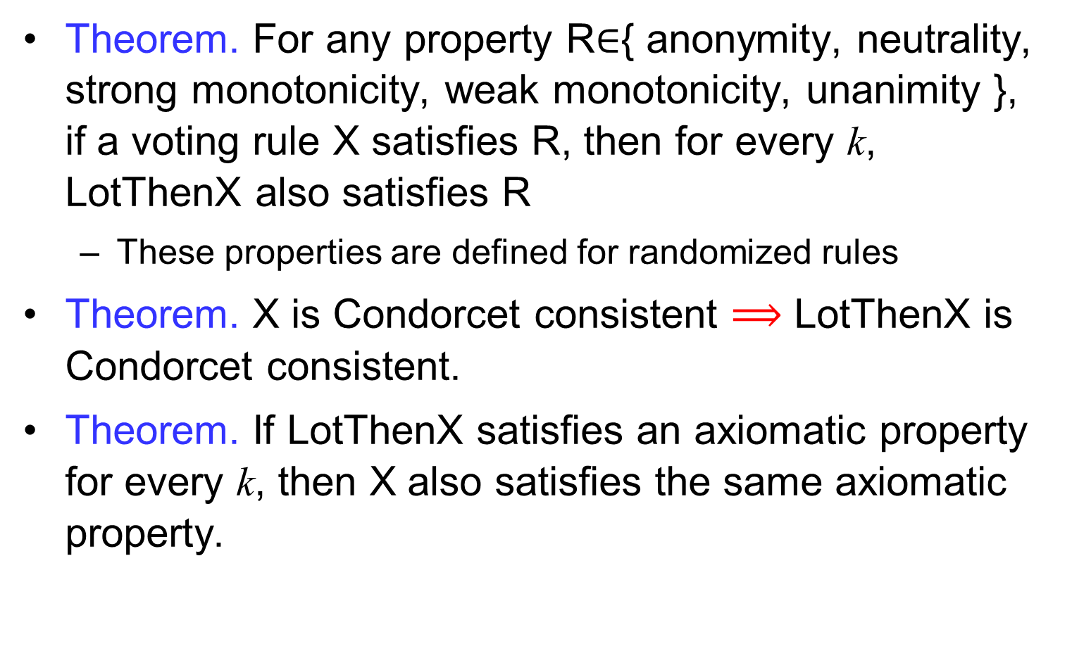
Axiomatic properties

Slide 27
Winner determination
EVALUATION: can a given candidate win with a probability strictly larger than p
Is the probability greater than p that we land a world in which the lottery selects voters who then elect this candidate?

Slide 28
Winner determination
EVALUATION: can a given candidate win with a probability strictly larger than p
NB actually computing the winner in any of these worlds is polynomial (supposing X is polynomial itself)

Slide 29
Winner determination
EVALUATION: can a given candidate win with a probability strictly larger than p
Theorem.
  EVALUATION for LotThenBorda is NP-hard
Theorem. Computing the probability for a given candidate to win under LotThenBorda is #P-complete

Slide 30
Winner determination
EVALUATION: can a given candidate win with a probability strictly larger than p
Theorem.
  EVALUATION for LotThenCopeland is NP-hard
Theorem.
  EVALUATION for LotThenMaximin is NP-hard
Theorem.
  EVALUATION for LotThenRankedPairs is NP-hard

Slide 31
Reminder
Copeland
  Each candidate gets 1 point every time they pairwise beat another candidate, highest scoring candidate wins
Maximin
  Score in any pairwise election is #votes for - #votes against, candidate’s overall score is smallest such score, winner is candidate with highest overall score
Ranked Pairs
  Take each unordered pair in turn, order according to pairwise election between them unless this violates transitivity. Top of this ordering is winner.

Slide 32
Small elections?
Theorem. EVALUATION for LotThenCup is NP-hard when votes are weighted and there are 3 or more candidates
Theorem. EVALUATION for LotThenApproval is not in P (supposing P≠NP) for weighted votes and 2 or more candidates
  Polynomial-time Turing reduction of SUBSET-SUM to EVALUATION for LotThenApproval

Slide 33
Small elections?
Theorem. EVALUATION for LotThenCup is NP-hard when votes are weighted and there are 3 or more candidates
Theorem. EVALUATION for LotThenMajority is not in P (supposing P≠NP) for weighted votes and 2 candidates
  Polynomial-time Turing reduction of SUBSET-SUM to EVALUATION for LotThenMajority

Slide 34
Discussion
Does it make sense to use a voting rule where EVALUATION is hard?
May not be a big problem for the truthful voters
Deciding the winner is in P
  Easier than Kemeny, Slater, and Dodgson

Slide 35

Manipulation
Fixed manipulation
  Given other voters, favoured candidate and probability p
  Can we cast fixed vote to make candidate win with probability > p ?

Slide 36
Manipulation
Improving manipulation
  Given other voters, favoured candidate and truthful vote
  Can we cast fixed vote to make candidate win with greater probability?

Slide 37
Manipulation
Theorem. IMPROVING MANIPULATION is polynomial for LotThenPlurality
  Vote for candidate!

Slide 38
Manipulation
Theorem. IMPROVING MANIPULATION is polynomial for LotThenPlurality
  Vote for candidate!
Conjecture. FIXED MANIPULATION is NP-hard for LotThenPlurality

Slide 39
Bound candidates/manipulators
Theorem. FIXED and IMPROVING MANIPULATION is polynomial for LotThenX if X is anonymous, and #candidates and #manipulators are both bounded

Slide 40
Manipulation
Theorem. FIXED and IMPROVING MANIPULATION is NP-hard for LotThenBorda with a single manipulator
  NB Borda is polynomial to manipulate with one manipulator, and NP-hard with two [AAAI/IJCAI 2011 best papers]

Slide 41
Manipulation
Theorem. FIXED and IMPROVING MANIPULATION is NP-hard for LotThenSTV with a single manipulator
  NB STV is NP-hard to manipulate with one manipulator

Slide 42
Manipulation
Theorem. FIXED and IMPROVING MANIPULATION is NP-hard for LotThenRankedPairs with a single manipulator
  NB RankedPairs is NP-hard to manipulate with one manipulator

Slide 43
Manipulation
Theorem. FIXED and IMPROVING MANIPULATION is NP-hard for LotThenCopeland with a single manipulator
  NB 2nd order Copeland is NP-hard to manipulate with one manipulator

Slide 44
Manipulation
Theorem. FIXED and IMPROVING MANIPULATION is NP-hard for LotThenMaximin with a single manipulator
  NB Maximin is NP-hard to manipulate with two manipulators

Slide 45
Discussion
Now have several methods to make manipulation (computationally) harder
  Adding a randomized pre-round to eliminate some alternatives [Conitzer&Sandholm 03, Elkind&Lipmaa 05]

Slide 46
Discussion
Now have several methods to make manipulation (computationally) harder
  Adding a randomized pre-round to eliminate some alternatives [Conitzer&Sandholm 03, Elkind&Lipmaa 05]
  Multi-stage voting (as done in STV, Nanson’s and Baldwin’s rules) [Narodytska et al. 11]

Slide 47
Discussion
Now have several methods to make manipulation (computationally) harder
  Randomized tie-breaking [Obraztsova et al. 11, Obraztsova&Elkind 11]

Slide 48
Discussion
Now have several methods to make manipulation (computationally) harder
  Randomized tie-breaking [Obraztsova et al. 11, Obraztsova&Elkind 11]
  Restricting the manipulator’s information [Conitzer et al. 11]

Slide 49
Discussion
Now have several methods to make manipulation (computationally) harder
  Randomized tie-breaking [Obraztsova et al. 11, Obraztsova&Elkind 11]
  Restricting the manipulator’s information [Conitzer et al. 11]
  Randomly eliminating some voters

Slide 50
Summary
LotThenX inspired by Venetian elections
  Winner determination
  Manipulation
  Both problems become computationally harder
Future work
  Voting for a subset of yourselves
  The 10 round Venetian rule
Thank you!

