Slide 1
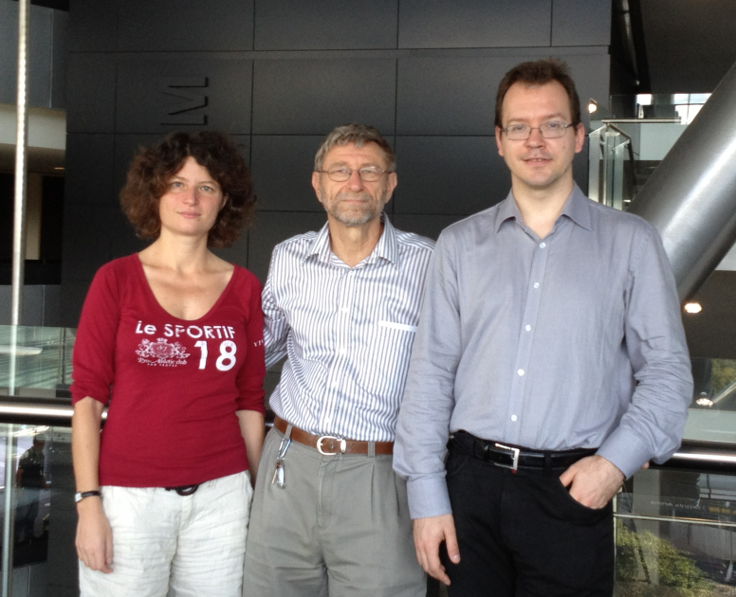
Exploring and Exploiting Clones in Elections
Edith Elkind
Nanyang Technological University, Singapore
Piotr Faliszewski
AGH Univeristy of Science
and Technology, Poland
Arkadii Slinko University of Auckland New Zealand

Slide 2
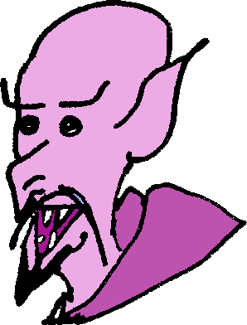
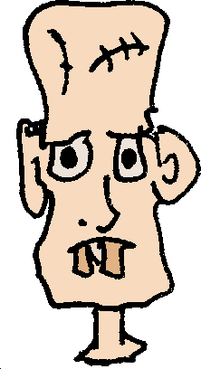
Elections for the Scariest Monster!
C = { , , , }
Borda voting

Slide 3
Elections for the Scariest Monster!
→ 18
→ 17
R₁:
R₂:
R₃:

Slide 4
Elections for the Scariest Monster!
→ 18
→ 17
R₁:
R₂:
R₃:

Slide 5
Elections for the Scariest Monster!
→ 6
→ 7
→ 18
→ 17
R₁:
Not so easy! Which candidates to colapse?
R₂:
R₃:

Slide 6
Elections for the Scariest Monster!
R₁:
R₂:
R₃:

Slide 7
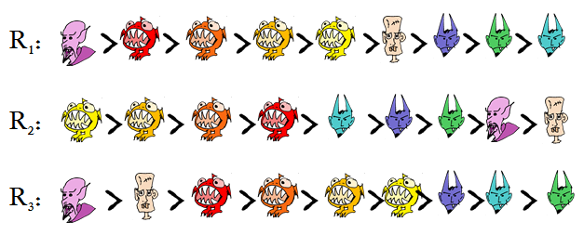
Problem 1: Discovering the True Elections
We start with an election with possible clones:
For each set of clones we have some likelihood that exactly this set resulted from cloning
We seek a clone cover that has highest likelihood
→ 0.01
→ 0.8
→ 0.5
→ 0.3
set
→ 1
→ 1
→ 1
All other subsets have likelihood 0.

Slide 8
Problem 1: Discovering the True Elections
→ 0.01
→ 0.8
→ 1
→ 0.5
→ 0.3
→ 1
→ 1
→ 1
→ 0.3
All other subsets have likelihood 0.
→ 0.5
→ 0.8
→ 0.8
→ 0.8

Slide 9
Problem 2: Decloning to Become a Winner
We start with an election with possible clones, and with a preferred candidate:
For each set of clones we have some likelihood that exactly this set resulted from cloning
We seek a clone cover that ensures that our guy wins.
→ 0.01
→ 0.8
→ 0.5
→ 0.3
→ 1
→ 1
→ 1
All other subsets have likelihood 0.

Slide 10
Problem 2: Decloning to Become a Winner
What is the complexity of the decloning problem?
What other problem is it like?
Voting rules?
Plurality
K-approval
Veto
Maximin
Borda
Copeland
Control by deleting candidates → we are allowed to delete some of the clones
Problem 1: Discovering the true election!
Independnce of irrelevant clones: The score of a candidate remains constant irrespective how other candidates are clones

Slide 11
Problem 2: Decloning to Become a Winner
Independnce of irrelevant clones: The score of a candidate remains constant irrespective how other candidates are clones
Algorithm for rules satisfying IIC:
Let p be your preferred candidate
For each clone set including p:
Declone it
Remove all clone sets that intersect it
Compute its score (after decloning)
For each other clone set that does not intersect
Compute its score (after decloning)
If higher than score of p’s clone set then remove from possible clone sets
Compute the best clone cover with given clone sets

Slide 12
Problem 2: Decloning to Become a Winner
Independnce of irrelevant clones: The score of a candidate remains constant irrespective how other candidates are clones
Thereom. For every voting rule that satisfies IIC, the problem of decloning to become a winner is in P.
Corollary. The problem of decloning to become a winner is in P for Plurality, Veto, and Maximin.

Slide 13
Problem 2: Decloning to Become a Winner
What is the complexity of the decloning problem?
What other problem is it like?
Voting rules?
Plurality
K-approval
Veto
Maximin
Borda
Copeland
Control by deleting candidates → we are allowed to delete some of the clones
Problem 1: Discovering the true election!

Slide 14
Problem 2: Decloning to Become a Winner
What is the complexity of the decloning problem?
What other problem is it like?
Voting rules?
Plurality
K-approval
Veto
Maximin
Borda
Copeland
Control by deleting candidates → we are allowed to delete some of the clones
NP-completeness proofs ended up being quite simple… after we understood clone structures ☺

Slide 15
Problem 3: What Clone Structures Can Arise in Elections?
R₁:
R₂:
R₃:
C(R₁, R₂, R₃) = {{ }, { }, { }, { }, { } { }, { }, { }, { }, { }, { }, { }, { }, { }}

Slide 16
Problem 3: What Clone Structures Can Arise in Elections?
C(R₁, R₂, R₃) = {{ }, { }, { }, { }, { } { }, { }, { }, { }, { }, { }, { }, { }, { }}
Question 1: Is there a profile that implements this clone structure?
Question 2: What properties do clone structures have?
Question 3: How to represent clone structures?
Question 4: How many voters do you need for a given clone structure?
We provide an axiomatic characterization of possible clone structures.

Slide 17
Axiomatic Characterization
A – alternative set
F – a family of A subsets
F is a clone structure if and only if:
A1 {a} ∈ F for each a ∈ A
A2 ∅ ∉ F, A ∈ F

Slide 18
Axiomatic Characterization
A – alternative set
F – a family of A subsets
F is a clone structure if and only if:
A1 {a} ∈ F for each a ∈ A
A2 ∅ ∉ F, A ∈ F
A3 If C₁ and C₂ are in F and C₁ ⋂ C₂ ≠∅ then C₁ ⋂ C₂ and C₁ ⋃ C₂ are in F

Slide 19
Axiomatic Characterization
A – alternative set
F – a family of A subsets
F is a clone structure if and only if:
A1 {a} ∈ F for each a ∈ A
A2 ∅ ∉ F, A ∈ F
A3 If C₁ and C₂ are in F and C₁ ⋂ C₂ ≠∅ then C₁ ⋂ C₂ and C₁ ⋃ C₂ are in F
A4 If C₁ and C₂ are in F and C₁ ⋈ C₂ then C₁ - C₂ and C₂ - C₁ are in F
C₁ ⋈ C₂: C₁ ⋂ C₂ ≠∅ and C₁ - C₂ ≠∅, C₂ - C₁≠∅

Slide 20
Axiomatic Characterization
A – alternative set
F – a family of A subsets
F is a clone structure if and only if:
A1 {a} ∈ F for each a ∈ A
A2 ∅ ∉ F, A ∈ F
A3 If C₁ and C₂ are in F and C₁ ⋂ C₂ ≠∅ then C₁ ⋂ C₂ and C₁ ⋃ C₂ are in F
A4 If C₁ and C₂ are in F and C₁ ⋈ C₂ then C₁ - C₂ and C₂ - C₁ are in F
A5 Each member of F has at most two minimal supersets in F.

Slide 21
Axiomatic Characterization
A – alternative set
F – a family of A subsets
F is a clone structure if and only if:
A1 {a} ∈ F for each a ∈ A
A2 ∅ ∉ F, A ∈ F
A3 If C₁ and C₂ are in F and C₁ ⋂ C₂ ≠∅ then C₁ ⋂ C₂ and C₁ ⋃ C₂ are in F
A4 If C₁ and C₂ are in F and C₁ ⋈ C₂ then C₁ - C₂ and C₂ - C₁ are in F
A5 Each member of F has at most two minimal supersets in F.
A6 F is „acyclic”

Slide 22
Proof Idea for the Characterization
There are only two basic types of clone structures
Both satisfy our axioms, both compose → induction
(a) a string of sausages
(b) a fat sausage

Slide 23
Clone Structure Representations
How to conveniently represent the above clone structure?

Slide 24
Clone Structure Representations
X
X = { , , , , , , , , }
X

Slide 25
Clone Structure Representations
Y Z
X = { , , , , , , , , }
Y = { , , , }, Z = { , , }
X
Y Z

Slide 26
Clone Structure Representations
Y
X = { , , , , , , , , }
Y = { , , , }, Z = { , , }
X
Y Z

Slide 27
Clone Structure Representations
U
X = { , , , , , , , , }
Y = { , , , }, Z = { , , }
U = { , }
X
Y Z
U

Slide 28
Clone Structure Representations
X = { , , , , , , , , }
Y = { , , , }, Z = { , , }
U = { , }
X
Y Z
U

Slide 29
Problem 3: What Clone Structures Can Arise in Elections?
C(R₁, R₂, R₃) = {{ }, { }, { }, { }, { } { }, { }, { }, { }, { }, { }, { }, { }, { }}
Question 1: Is there a profile that implements this clone structure?
Question 2: What properties do clone structures have?
Question 3: How to represent clone structures?
Question 4: How many voters do you need for a given clone structure?

Slide 30
How Many Voters Needed to Represent a Clone Structure?
Strings of sausages
Fat sausages
a b c d
a b c d
a b c
a > b > c > d
a > b > c > d
c > a > d > b
a > b > c
a > c > b
b > a > c
A single voter suffices
Two voters suffice …
The only fat sausage that needs three voters!

Slide 31
How Many Voters Needed to Represent a Clone Structure?
X
Y
X with Y in place of b
a 1 2 3 4 c
a b c
1 2 3 4
a > b > c
b > a > c
1 > 2 > 3 > 4
4 > 2 > 3 > 1
a > 1 > 2 > 3 > 4 > c
4 > 2 > 3 > 1 > a > c

Slide 32
How Many Voters Needed to Represent a Clone Structure?
X Y X with Y in place of b
a 1 2 3 4 c
a b c
1 2 3 4
a > b > c
b > a > c
1 > 2 > 3 > 4
4 > 2 > 3 > 1
a > 1 > 2 > 3 > 4 > c
4 > 2 > 3 > 1 > a > c
1 > 3 > 2 > 4 > a > c

Slide 33
How Many Voters Needed to Represent a Clone Structure?
X Y X with Y in place of b
a 1 2 3 4 c
a b c
1 2 3 4
a > b > c
b > a > c
1 > 2 > 3 > 4
4 > 2 > 3 > 1
a > 1 > 2 > 3 > 4 > c
4 > 2 > 3 > 1 > a > c
1 > 3 > 2 > 4 > a > c
Theorem. For every clone structure F over alternative set A, there are three orders R₁, R₂, R₃ that jointly generate F.

Slide 34
Problem 2: Decloning to Become a Winner
What is the complexity of the decloning problem?
What other problem is it like?
Voting rules?
Plurality
K-approval
Veto
Maximin
Borda
Copeland
Control by deleting candidates → we are allowed to delete some of the clones

Slide 35
Problem 4: Decloning to Discover Hidden Structure
We start with an election;
Perhaps the elections satisfied:
Single-peakedness?
Single-crossingness?
But clones destroyed the structure?
Goal: Declone as little as possible to discover single-peakedness or single-crossingness.

Slide 36
Clones in Single-Peaked Elections
Single-peakedness models votes in natural elections
Def. An election (A,R) is single-peaked with respect to an order > if for all c, d, e in A such that c > d > e (or e > d > c) and all R_{i} it holds that:
c R_{i} d ⇒ c R_{i} e

Slide 37
Clones in Single-Peaked Elections
Single-peakedness models votes in natural elections
Def. An election (A,R) is single-peaked with respect to an order > if for all c, d, e in A such that c > d > e (or e > d > c) and all R_{i} it holds that:
c R_{i} d ⇒ c R_{i} e
Profile loses single-peakedness due to cloning

Slide 38
Decloning Toward Single-Peakedness
Decloning a clone set in (A,R)
Operation of contracting a clone-set into a single candidate
We have a polynomial-time algorithm that finds a decloning of a preference profile such that:
The profile becomes single-peaked
Maximum number of candidates remain in the election

Slide 39
Decloning Toward Single-Peakedness
Decloning
Operation of contracting a clone-set into a single candidate
We have a polynomial-time algorithm that finds a decloning of a preference profile such that:
The profile becomes single-peaked
Maximum number of candidates remain in the election

Slide 40
Decloning Toward Single-Peakedness
Decloning
Operation of contracting a clone-set into a single candidate
We have a polynomial-time algorithm that finds a decloning of a preference profile such that:
The profile becomes single-peaked
Maximum number of candidates remain in the election

Slide 41
Decloning Toward Single-Peakedness
Decloning
Operation of contracting a clone-set into a single candidate
We have a polynomial-time algorithm that finds a decloning of a preference profile such that:
The profile becomes single-peaked
Maximum number of candidates remain in the election

Slide 42
Characterizing Single-Peaked Clone Structures
It would be interesting to know what clones structures can be implemented by single-peaked profiles
Not all clone structures can be!
However, all clone structures whose tree representation contains P-nodes only can be implemented
Work in progress!

Slide 43
Clones in Single-Crossing Elections
Single-CrossingPreferences
a > b > c > d > e
b > a > c > d > e
b > c > a > d > e
c > b > a > e > d
c > b > e > a > d

Slide 44
Clones in Single-Crossing Elections
Single-Crossing Preferences
a > b > c > d > e
b > a > c > d > e
b > c > a > d > e
c > b > a > e > d
c > b > e > a > d
Every clone structure can be implemented.
Decloning toward single-crossing preferences is NP-complete.
Unless the order of voters is fixed; then it is in P.

Slide 45
Conclusions
Clone structures form an interesting mathematical object
Clones can be used in various ways to manipulate elections; understanding clone structures helps in this respect.
Clones can spoil single-peakedness of an election; decloning toward single-peakedness can be a useful preprocessing step when holding an election.
Thank You!

Slide 46
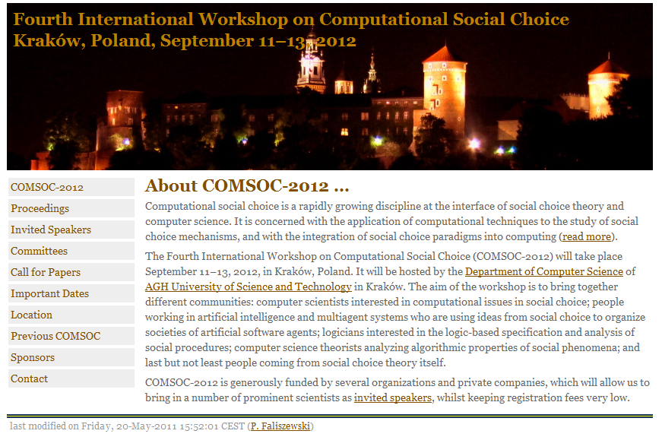
COMSOC-2012 in Kraków, Poland

